Slide 1
THE KALEIDOSCOPE OF IDENTITY: ILLUMINATING THE RIGHTS OF CHILDREN

Slide 2

WELCOME!
Get ready to embark on a creative journey exploring the kaleidoscope of identity and the rights of children. This presentation will delve into the multifaceted aspects of identity and shed light on the importance of protecting children's rights.

Slide 3
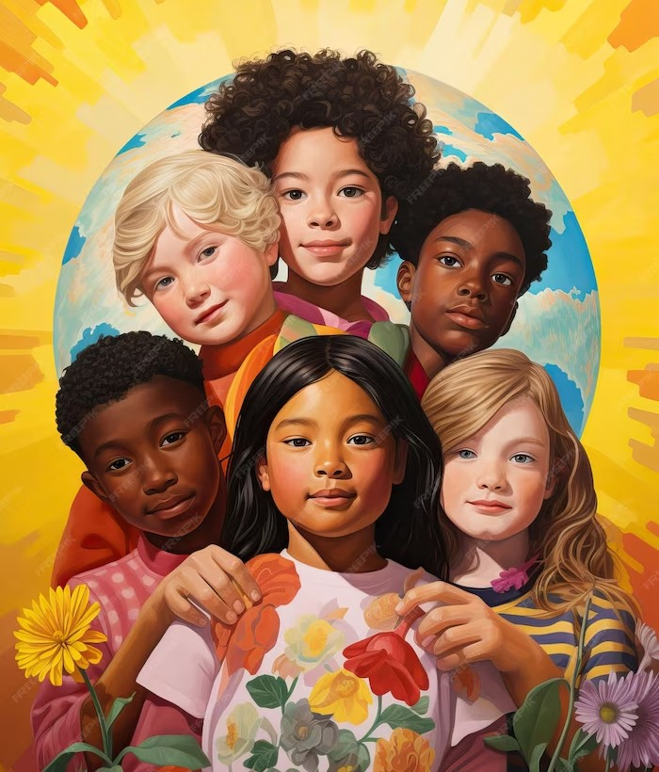
DEFINING IDENTITY
Identity is a complex concept that encompasses personal, cultural, and social dimensions. It shapes how children perceive themselves and interact with the world.
Understanding the various layers of identity is crucial in promoting inclusivity and safeguarding the rights of every child.

Slide 4
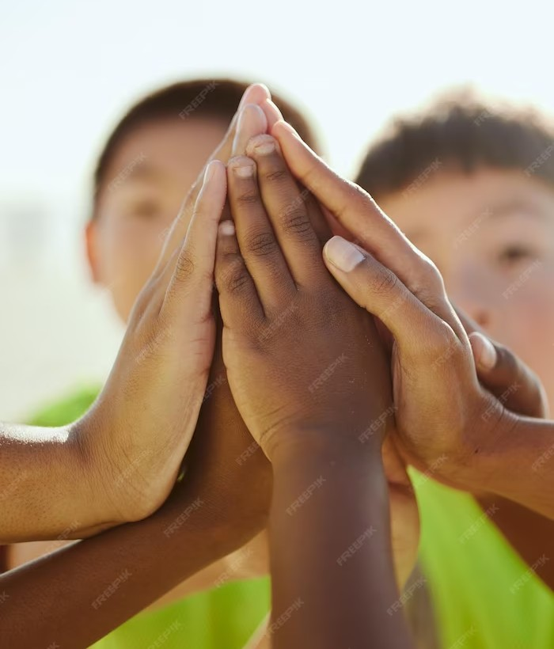
RIGHTS OF CHILDREN
Children have the right to be heard, protected, and nurtured. They deserve an environment that respects their individuality and provides equal opportunities for growth. By recognizing and upholding children's rights, we can empower them to ﬂourish and contribute positively to society.

Slide 5

EMBRACING DIVERSITY
In a world marked by diversity, it is essential to celebrate and embrace differences. By fostering an inclusive society that values and respects every child's unique identity, we can create a brighter future where children can thrive and fulﬁll their potential.

Slide 6
CONCLUSION
The kaleidoscope of identity illuminates the rich tapestry of children's lives. By nurturing their rights and embracing diversity, we can create a world where every child's potential is realized. Let us join hands and work towards a future where children are empowered, protected, and celebrated.

